Slide 1
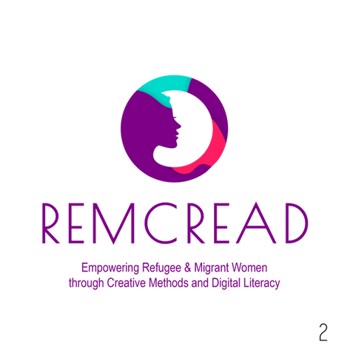


LAW AND ETHICS
ON THE INTERNET
Create copyright - compliant content
Digital Literacy In-Training Service
MODULE 1.3
Notes:
1.7.2013
‹#›

Slide 2


Create copyright
-compliant content
Creating content that complies with copyright law is essential for both creators and users. Understanding the basics of copyright and how to use content legally can help you avoid legal issues and ensure that your work is protected.
Photo designed by Freepik
Notes:
‹#›

Slide 3

Create your own content
It is safest to create your own original content, such as text, graphics, videos, music, etc. This way, you automatically acquire the copyright to your work and avoid the problems associated with copying other people's work.
Notes:
‹#›

Slide 4

Check the licenses for external materials
If you use other people's materials (photos, music, video), make sure you have the rights to them. Check the licenses that specify under what terms you can use the work (e.g. Creative Commons).
1
CC BY
you may use, provided you give credit to the author.
2
CC BY-SA
you may use and modify, provided you credit the author and share under the same license.
3
CC BY-ND
you may use, but without modification.
4
CC BY-NC
you can use, but non-commercial.
Notes:
‹#›

Slide 5

Use of public domain resources
Works that have passed into the public domain can be used freely because the copyright has expired (usually 70 years after the author's death). You can use such materials without fear of infringement.
Notes:
‹#›

Slide 6

Permissions for commercial use
If you plan to commercialize your content (e.g., through monetization on YouTube), make sure you have the rights to use all elements, such as music, photos or graphics. Even if something is available for free for personal use, it doesn't mean you can use it commercially.
Notes:
‹#›

Slide 7

How to protect your own content?
Keep evidence of the creation of your works
It is always a good idea to have evidence that you are the author of your works. This can include working records, file metadata, file creation dates, and even emailing yourself a version of the work (although this is more of a token safeguard).
Notes:
‹#›

Slide 8

Use copyright protection tools
Online platforms such as YouTube and Facebook offer copyright protection tools, such as Content ID. Register your content and monitor its use so you can report infringements.
Notes:
‹#›

Slide 9

Licensing your own content
If you want to share your works, you can choose an appropriate license that determines under what terms others can use your works (e.g. Creative Commons licenses).
Notes:
‹#›

Slide 10
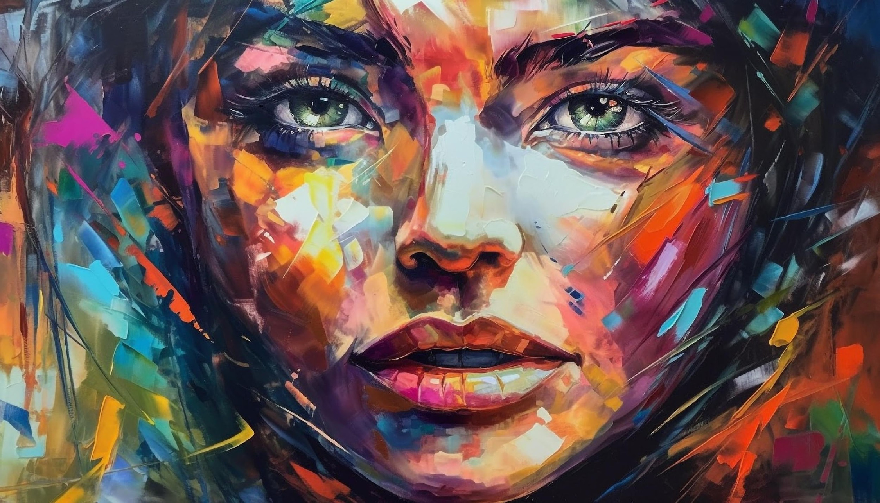
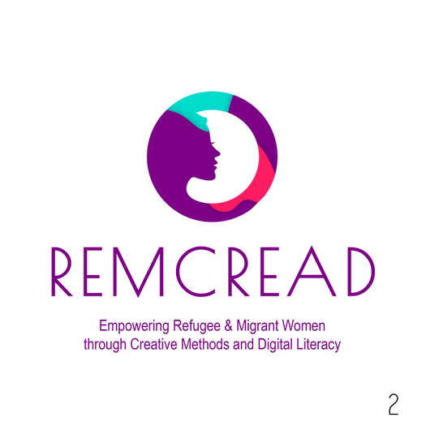
”STOP DREAMING
AND START
DOING”

Slide 11

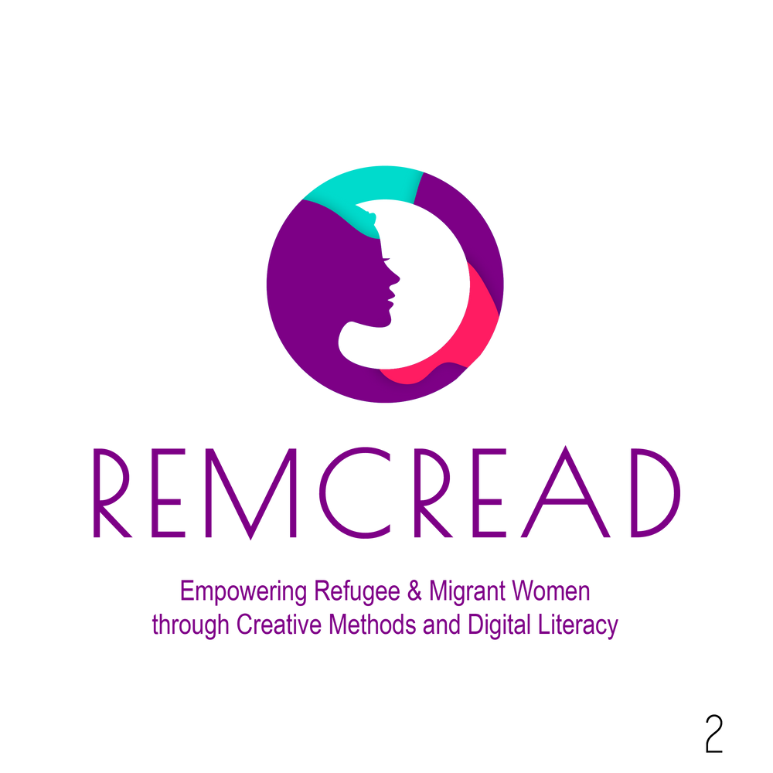

Funded by the European Union. Views and opinions expressed are however those of the author(s) only and do not necessarily reflect those of the European Union or the European Education and Culture Executive Agency (EACEA). Neither the European Union nor EACEA can be held responsible for them.
Project no. 2023-1-PL01-KA220-ADU-000156610
More info about the project:
https://www.remcreadwomen.eu/
11

